Slide 1
Introduction to Functional Dependencies
Let R be a relation and A & B be the sub-sets of attributes of R, then B is said to be functionally dependent on A if given A we can accurately determine B.
If B is functionally dependent on A then it is denoted as A→B.
Example:
Emp_Project (Eid, EName, Proj_Name, Proj_No, Proj_LOC, Hours)
The following FDs exists in above relation
1. Eid → EName
Given Id of employee we can find the name of the employee corresponding to that Id.

Slide 2
2. Proj_No → Proj_Name, Proj_Loc
Given project number, we can find out the project corresponding to that project number. Similarly we can find project LOC from Proj_No.
3. {Eid, Proj_No} → Hours
Given Employee Id and project number on which an employee is working, we can find no of hours worked by each employee on a particular project.
4. EName --><→ EId
EName does not functionally determine EId because there may be two employees with the same name.

Slide 3
Fully Functional Dependency
Let R be the relation then an attribute B is said to be fully functionally dependent on attribute A if it is functionally dependent on A and not functionally dependent on any proper subset of A.
The following FD
{Eid, Proj_No, Proj_LOC} → Hours, is not fully functionally dependent on the set on the left hand side because no of hours worked can also be determined by a sub-set of set on left side of FD.
{Eid, Proj_No} → Hours, Hour is now fully functionally dependent on Eid and Proj_No because neither Eid nor proj_No alone can determine number of hours worked by employee.

Slide 4
Trivial Functional Dependency
A FD is trivial if and only if the right hand side attribute(s)
is a sub-set of the left hand side attribute(s),
A→B, where B is sub-set of A
Example,
Customer_name → Customer_name
{Customer_name, loan_number} → Customer_name

Slide 5
Non-Trivial Functional Dependency
An FD in which at least one attribute on right hand side of FD is not contained in left side attributes of FD
A→B, where B is not a sub-set of A
Example
{Eid, Proj_No} → Hours,
Here Hours is not a sub-set of {Eid, Proj_No}

Slide 6
NORMALIZATION
Normalization is a process by which we efficiently organize data to achieve these goals:
  Eliminating Redundancy,
  Ensuring data is stored in the correct table,
  Eliminating need of restructuring the database when data is added.

Slide 7
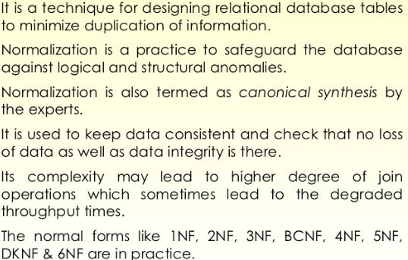
Normalization integrity

Slide 8
First Normal Form (1NF)
There are no repeating or duplicate fields.
Each cell contains only a single value.
Each record is unique
Identified primary key.

Slide 9
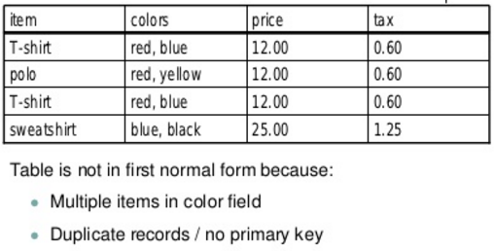
Example 1NF

Slide 10
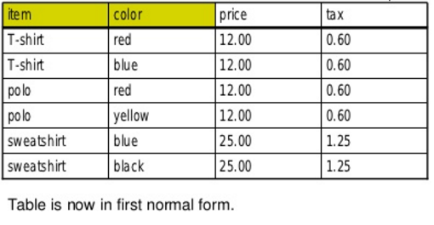

Slide 11
Second Normal Form (2NF)
A relation is said to be in 2NF if it is in 1NF and every non-prime attribute of R is fully functionally dependent on primary key of R.
Another way to say this: A relation is in second normal form if it is free from partial-key dependencies
Relations that have a single attribute for a key are automatically in 2NF.

Slide 12
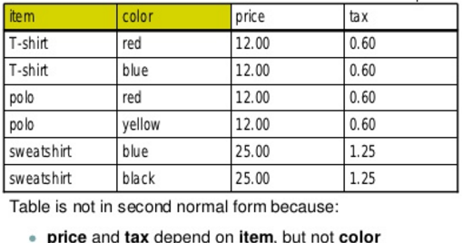

Slide 13
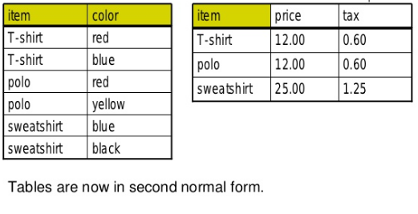

Slide 14
Third Normal Form (3NF)
A relation is said to be in 3NF if it is in 2NF and no non-prime attribute of R is transitivity dependent on primary key of R.

Slide 15
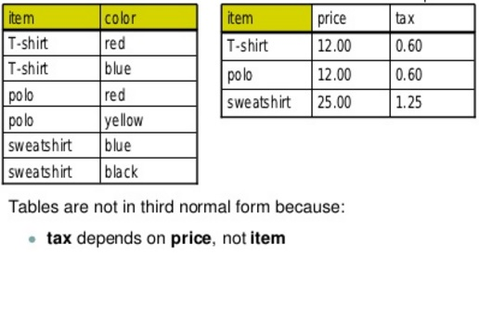

Slide 16
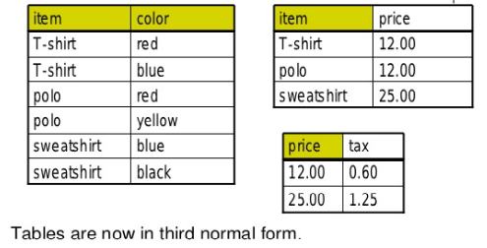

Slide 17
Example of 1NF
Consider a table which is not in First normal form
Student Table :
Student | Age | Subject
Adam | 15 | Biology, Maths
Alex | 14 | Maths
Stuart | 17 | Maths

Slide 18
Example of 1NF
Student Table1 following 1NF will be :
Student | Age | Subject
Adam | 15 | Biology
Adam | 15 | Maths
Alex | 14 | Maths
Stuart | 17 | Maths

Slide 19
Example of 2NF
Consider a table which is not in 2NF
Student Table1 :
Student | Age | Subject
Adam | 15 | Biology
Adam | 15 | Maths
Alex | 14 | Maths
Stuart | 17 | Maths

Slide 20
New Student_Table2 following 2NF will be :
In Student Table the candidate key will be Student column, because all other column i.e Age is dependent on it.
New Subject_Table introduced for 2NF will be :
In Subject Table the candidate key will be {Student, Subject} column.
Student | Subject
Adam | Biology
Adam | Maths
Alex | Maths
Stuart | Maths
Student | Age
Adam | 15
Alex | 14
Stuart | 17
Now, both the above tables qualifies for Second Normal Form and will never suffer from Update Anomalies. Although there are a few complex cases in which table in Second Normal Form suffers Update Anomalies, and to handle those scenarios Third Normal Form is there.

Slide 21
Example of 3NF
Third Normal form applies that every non-prime attribute of table must be dependent on primary key, or we can say that, there should not be the case that a non-prime attribute is determined by another non-prime attribute. So this transitive functional dependency should be removed from the table and also the table must be in Second Normal form. For example, consider a table with following fields.
Student_Detail Table :
Student_id | Student_name | DOB | Street | city | State | Zip

Slide 22
Example of 3NF
In this table Student_id is Primary key, but street, city and state depends upon Zip. The dependency between zip and other fields is called transitive dependency. Hence to apply 3NF, we need to move the street, city and state to new table, with Zip as primary key.
Student_Detail Table1 :
Student_id | Student_name | DOB | Zip
Address Table:
Zip | Street | city | state

Slide 23
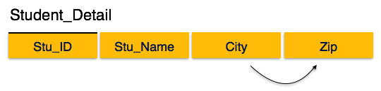
Third Normal Form
For a relation to be in Third Normal Form, it must be in Second Normal form and the following must satisfy −
No non-prime attribute is transitively dependent on prime key attribute.

Slide 24
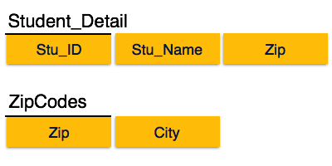
We find that in the above Student_detail relation, Stu_ID is the key and only prime key attribute. We find that City can be identified by Stu_ID as well as Zip itself. Neither Zip is a superkey nor is City a prime attribute. Additionally, Stu_ID → Zip → City, so there exists transitive dependency.
To bring this relation into third normal form, we break the relation into two relations as follows −

Slide 25
END of Part-1

Slide 26
Sources
www.studytonight.com/dbms/database-normalization.php
www.tutorialspoint.com/dbms/pdf/database_normalization.pdf
www.tutorialspoint.com/dbms/dbms_storage_system.htm
www.tutorialcup.com/dbms/boyce-codd-normal-form.htm
Other Books.

